Slide 1
THE REVOLUTION
BY
Anvay Nandurkar
Rajat Agarawal
Utsav Pitroda
Anjuman Polytechnic

Slide 2
Revolution
Introduction
A revolution is a fundamental change in power or organizational structures that takes place in a relatively short period of time. Revolutions have occurred through human history and vary widely in terms of methods, duration, and motivating ideology. Their results include major changes in culture, economy, and socio political institutions.
Revolutions can be of many types. Some of the revolutions are stated below:-
Green Revolution
Scientific Revolution
Industrial Revolution
Chemical Revolution

Slide 3
Green Revolution
Introduction
Green Revolution usually
refers to the transformation
of agriculture that began in
1945. With the experience of agricultural development begun in Mexico by Norman Borlaug in 1943 . In 1961 India was on the brink of mass famine. Norman Borlaug was invited to India by the adviser to the Indian minister of agriculture in the most basic sense; the Green Revolution was a product of globalization.

Slide 4
Green Revolution in India
Initiation
The rate of growth decreased significantly in the late 1980s.
The program was started with the help of the United States-based Rockefeller Foundation and was based on high-yielding varieties of wheat, rice and other grains that had been developed in Mexico and in the Philippines.

Slide 5
Green Revolution in India
Results
The major benefits of the Green Revolution were experienced mainly in Punjab and Haryana between 1965 and the early 1980s. By FY 1980, almost 75 percent of the total cropped area under wheat was sown with high-yielding varieties. For rice the comparable figure was 45 percent. The plan was implemented only in areas with assured supplies of water and the means to control it, large inputs of fertilizers, and adequate farm credit. Thus it proved a great success in India and it is also implemented in the another parts of India.

Slide 6
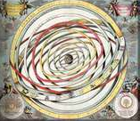
Scientific revolution
Introduction
The period which
many historians of
science call the
Scientific Revolution is commonly viewed as the foundation and origin of modern science. The Scientific Revolution can be roughly dated as having begun in 1543.

Slide 7
Scientific revolution
He Scientific Revolution was not marked by any single change. The following new ideas contributed to the Scientific Revolution
The replacement of the Earth by the Sun as the center of the solar system.
The replacement of the Aristotelian theory that matter was continuous and made up of three elements Earth, Water, Air, Fire, and ether.
The replacement of the Aristotelian idea that by their nature, heavy bodies moved straight down toward their natural places.

Slide 8
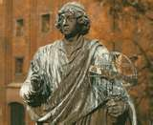
Scientific revolution
Nicolas Copernicus(1473–1543)
published On the Revolutions
of the Heavenly Spheres in 1543,
which advanced the heliocentric theory of cosmology.

Slide 9
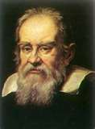
Scientific revolution
Galileo Galilei (1564–1642)
improved the telescope, with
which he made several important astronomical discoveries, including
the four largest moons of Jupiter the phases of Venus, and the rings of Saturn, and made detailed observations of sunspots.

Slide 10
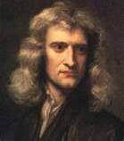
Scientific revolution
Isaac Newton (1643–1727)
built upon the work of Kepler
and Galileo.
Newton taught that scientific theory should be coupled with rigorous experimentation, which became the keystone of modern science.

Slide 11
Scientific revolution
Contrary Views
A contrary view has been recently proposed by Arun Bala in his dialogical history of the birth of modern science. Bala argues that by ignoring multicultural impacts we have been led to a Eurocentric conception of the Scientific Revolution. Thus, Scientific Revolution has been a great landmark in world history.

Slide 12
Industrial Revolution
Introduction
The Industrial Revolution was a period in the late 18th and early 19th centuries when major changes in agriculture, manufacturing, production, and transportation had a profound effect on the socioeconomic and cultural conditions. It firstly took place in Britain.

Slide 13
Industrial Revolution
Innovations
Textiles - Cotton spinning using Richard Arkwright's water frame, James Hargreaves's Spinning Jenny, and Samuel Crompton's Spinning Mule (a combination of the Spinning Jenny and the Water Frame).
Steam power - The improved steam engine invented by James Watt was initially mainly used for pumping out mines, but from the 1780s was applied to power machines.

Slide 14
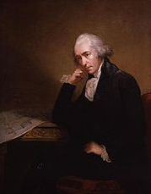
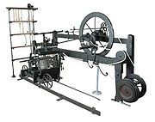
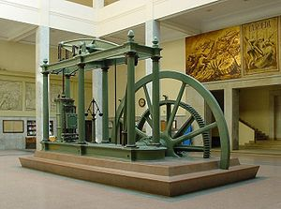
Industrial Revolution
James Watt
Spinning Mule
Watt’s steam engine

Slide 15
Industrial Revolution
Innovations
Iron founding - In the Iron industry, coke was finally applied to all stages of iron smelting, replacing charcoal. This had been achieved much earlier for lead and copper as well as for producing pig iron in a blast furnace, but the second stage in the production of bar iron depended on the use of potting and stamping.
Glass making - A new method of producing glass, known as the cylinder process, was developed in Europe during the early 19th century.

Slide 16
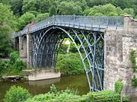
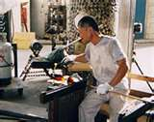
Industrial Revolution
Iron Bridge
Glass Making

Slide 17
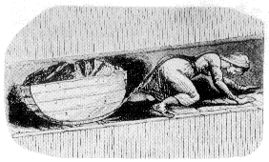
Industrial Revolution
Thus new innovations grew in the Industrial Revolution. After that new innovations grew in the 18 ^{th} and 19 ^{th}
centuries such as
Roads
Railways
Mining
Coal industries Child Labour
Due to this revolution in Britain it expanded in U.S.A., France, Germany, Japan etc. But, some problems grew i.e. child labour, capitalism etc.

Slide 18
Chemical Revolution
Introduction
The Chemical Revolution, also called the first chemical revolution, denotes the reformulation of chemistry based on the Law of Conservation of Matter and the oxygen theory of combustion. Several factors led to this revolution, such as proof that air was not an element but was composed of seven different gases. Chemists such as Henry Cavendish and Joseph Priestley performed important experiments to prove these facts.

Slide 19
Chemical Revolution
Start of Chemical Revolution
The revolution started with the 1789 publication of Lavoisier's Elements of Chemistry. Beginning with this publication and others to follow, Lavoisier discovered the composition of air and water and coined the term "oxygen". He also explained the theory of combustion, and did away with the phlogiston theory with his views on caloric. The Traite incorporates notions of a "new chemistry" and describes the experiments and reasoning that led to Lavoisier's conclusions.

Slide 20
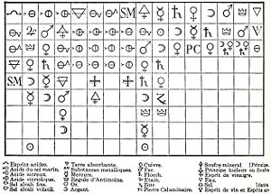
Chemical Revolution
Geoffroy’s Affinity Table :at the head of each column is a chemical species with which all the species below can combine.

Slide 21
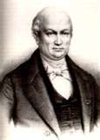
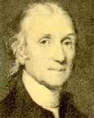
Chemical Revolution
Geoffroy
Henry Cavendish

Slide 22
Chemical Revolution
Contrary views
In sum, Lavoisier's Traite did for chemistry. In the chemical revolution, modern chemists disproved facts that had been theorized by the Ancient Greeks and accepted ever since. For example, chemists began to denote that all structures were composed of more than four elements.
Thus this revolution has made great revolution in the field of revolutions.

Slide 23
At last these revolutions played a great role in the world history. The future revolution will be 4G and we should be ready to welcome it and be a part of it.

Slide 24
“You cannot buy the Revolution, You cannot make the Revolution, You an only be the Revolution”. Thank You

Slide 25
This powerpoint was kindly donated to www.worldofteaching.com
http://www.worldofteaching.com is home to over a thousand powerpoints submitted by teachers. This is a completely free site and requires no registration. Please visit and I hope it will help in your teaching.

